Slide 1

Revolutionizing Plant Disease Management: An App-Based Solution for Accurate Identiﬁcation
20CS713 Project Phase- I
Baalaji Sakthivel
Gokulavasan
Rahul mondal
Mentor: Dr. Geetha, M.E,Ph.d, Professor

Slide 2
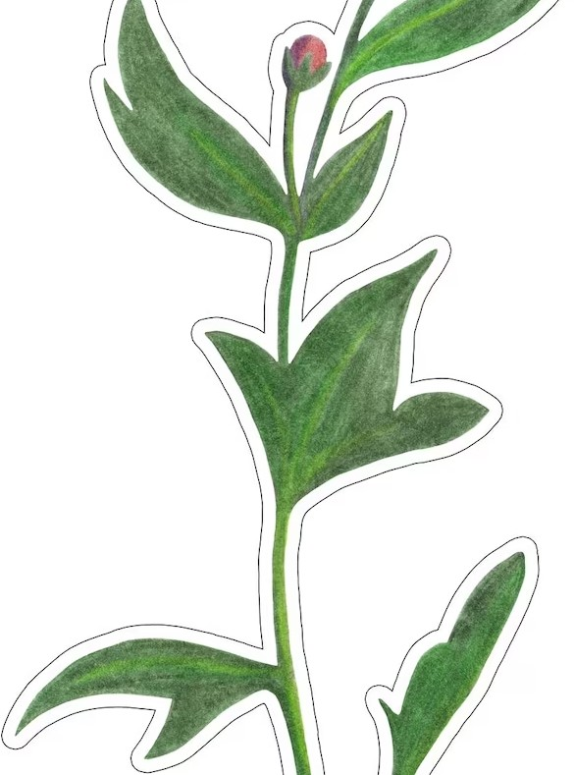
Revolutionizing Plant Disease Management
Plant diseases can cause devastating losses to crops, leading to economic and social impacts. Our app-based solution aims to identify and resolve plant diseases quickly and accurately, reducing the risk of crop losses and
increasing yields.

Slide 3
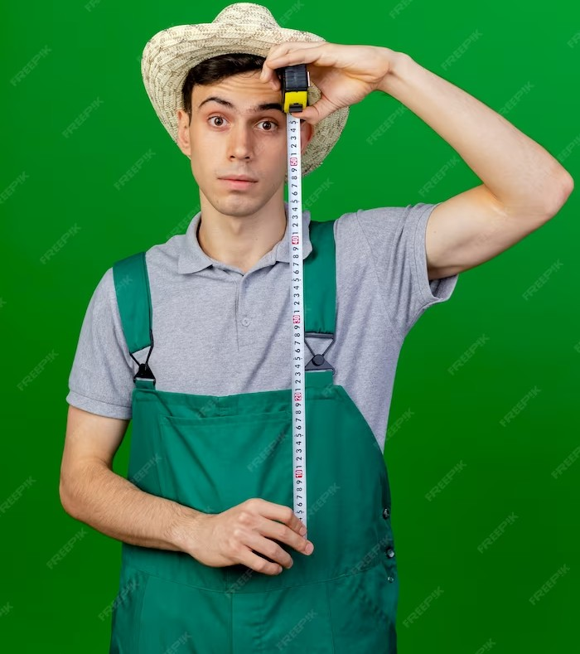
The Problem with Traditional Plant Disease
Management
Traditional methods of plant disease management rely on visual inspection and experience. This can lead to misidentiﬁcation of diseases and ineffective treatment. Our app-based solution utilizes machine learning and image recognition to accurately identify plant diseases and recommend effective treatment.

Slide 4
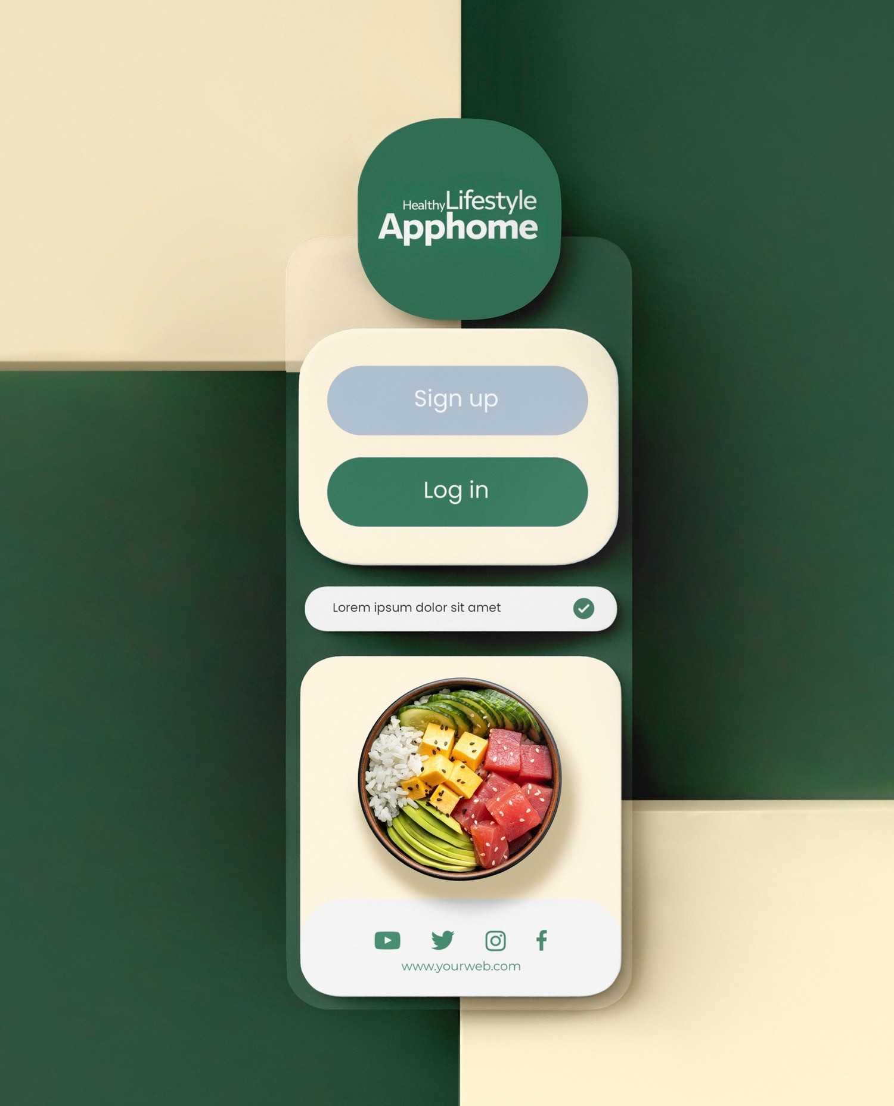
How Our App Works
Our app utilizes image recognition technology to identify plant diseases. Users simply take a picture of the affected plant and the app provides an accurate diagnosis and recommended treatment. The app also provides real-time updates on disease outbreaks and treatment effectiveness.

Slide 5
LITERATURE SURVEY
1. Effective Classification Of Plant Disease Using Image Processing And Machine Learning – (https://ieeexplore.ieee.org/document/9696947)
2. Plant Disease Detection using Image Processing with Machine Learning
- (https://ieeexplore.ieee.org/document/10192986)

Slide 6
Conclusion
Our app-based solution revolutionizes plant disease management by providing accurate to plant diseases. By utilizing machine learning and image recognition, our app provides a more effective and efﬁcient way to manage plant diseases, leading to increased crop yields and economic beneﬁts.

Slide 7
Thanks!

